Slide 1

Master Method
Nav Sanya Anand

Slide 2
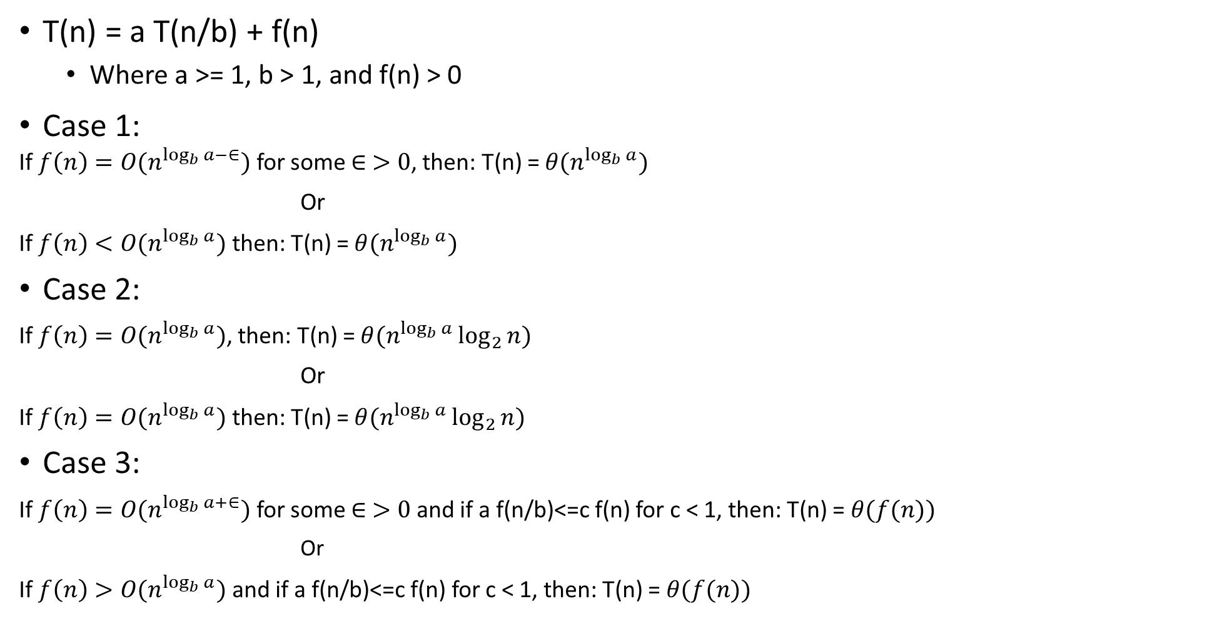
Points to Note
T(n) = a T(n/b) + f(n)
Where a >= 1, b > 1, and f(n) > 0
Case 1:
If $f\left(n\right)=O(n^{\log_{b}{a−∈}})$ for some $∈ >0$, then: T(n) = $θ(n^{\log_{b}{a}})$
Or
If $f\left(n\right)<O(n^{\log_{b}{a}})$ then: T(n) = $θ(n^{\log_{b}{a}})$
Case 2:
If $f\left(n\right)=O(n^{\log_{b}{a}})$, then: T(n) = $θ(n^{\log_{b}{a}}\log_{2}{n})$
Or
If $f\left(n\right)=O(n^{\log_{b}{a}})$ then: T(n) = $θ(n^{\log_{b}{a}}\log_{2}{n})$
Case 3:
If $f\left(n\right)=O(n^{\log_{b}{a+∈}})$ for some $∈ >0$ and if a f(n/b)<=c f(n) for c < 1, then: T(n) = $θ(f(n))$
Or
If $f\left(n\right)>O(n^{\log_{b}{a}})$ and if a f(n/b)<=c f(n) for c < 1, then: T(n) = $θ(f(n))$

Slide 3
Points to Note
T(n) = a T(n/b) + f(n)
Where a >= 1, b > 1, and f(n) > 0
Case 1:
If $f\left(n\right)=O(n^{\log_{b}{a−∈}})$ for some $∈ >0$, then: T(n) = $θ(n^{\log_{b}{a}})$
Or
If $f\left(n\right)<O(n^{\log_{b}{a}})$ then: T(n) = $θ(n^{\log_{b}{a}})$
Case 2:
If $f\left(n\right)=O(n^{\log_{b}{a}})$, then: T(n) = $θ(n^{\log_{b}{a}}\log_{2}{n})$
Or
If $f\left(n\right)=O(n^{\log_{b}{a}})$ then: T(n) = $θ(n^{\log_{b}{a}}\log_{2}{n})$
Case 3:
If $f\left(n\right)=O(n^{\log_{b}{a+∈}})$ for some $∈ >0$ and if a f(n/b)<=c f(n) for c < 1, then: T(n) = $θ(f(n))$
Or
If $f\left(n\right)>O(n^{\log_{b}{a}})$ and if a f(n/b)<=c f(n) for c < 1, then: T(n) = $θ(f(n))$

Slide 4
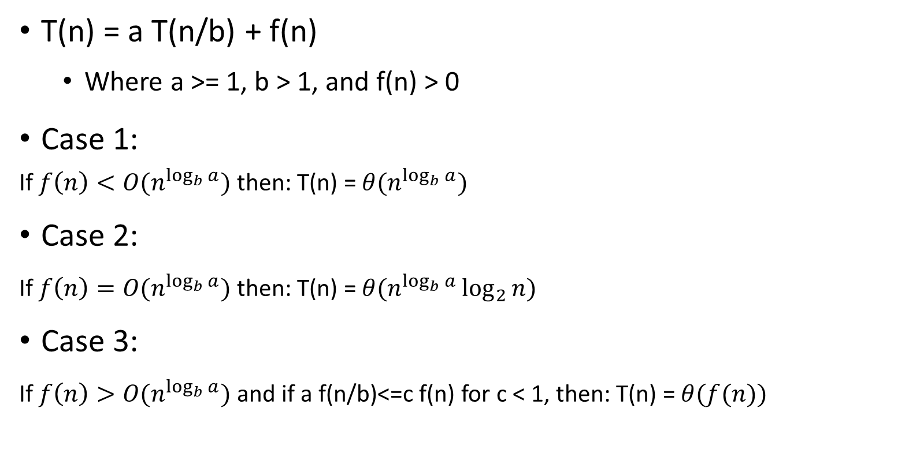
Points to Note
T(n) = a T(n/b) + f(n)
Where a >= 1, b > 1, and f(n) > 0
Case 1:
If $f\left(n\right)<O(n^{\log_{b}{a}})$ then: T(n) = $θ(n^{\log_{b}{a}})$
Case 2:
If $f\left(n\right)=O(n^{\log_{b}{a}})$ then: T(n) = $θ(n^{\log_{b}{a}}\log_{2}{n})$
Case 3:
If $f\left(n\right)>O(n^{\log_{b}{a}})$ and if a f(n/b)<=c f(n) for c < 1, then: T(n) = $θ(f(n))$

Slide 5
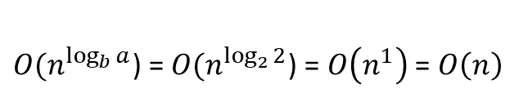
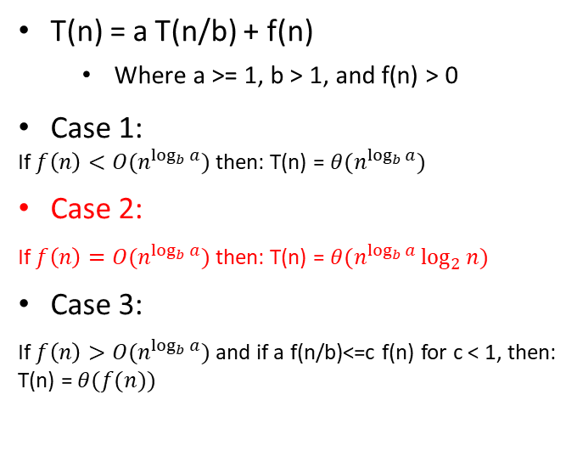
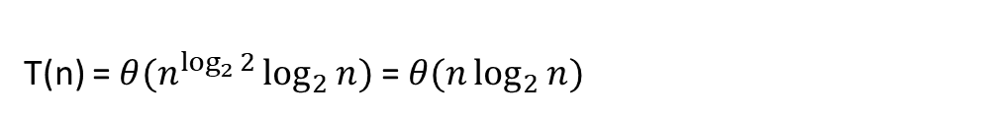
Example 1 - T(n) = n + 2T(n/2)
a = 2, b = 2, f(n) = n
T(n) = a T(n/b) + f(n)
Where a >= 1, b > 1, and f(n) > 0
Case 1:
If $f\left(n\right)<O(n^{\log_{b}{a}})$ then: T(n) = $θ(n^{\log_{b}{a}})$
Case 2:
If $f\left(n\right)=O(n^{\log_{b}{a}})$ then: T(n) = $θ(n^{\log_{b}{a}}\log_{2}{n})$
Case 3:
If $f\left(n\right)>O(n^{\log_{b}{a}})$ and if a f(n/b)<=c f(n) for c < 1, then: T(n) = $θ(f(n))$
$O(n^{\log_{b}{a}}$) = $O(n^{\log_{2}{2}}$) = $O\left(n^{1}\right)$ = $O\left(n\right)$
f(n) = n = O(n) Case 2
T(n) = $θ(n^{\log_{2}{2}}\log_{2}{n})$ = $θ(n\log_{2}{n})$

Slide 6
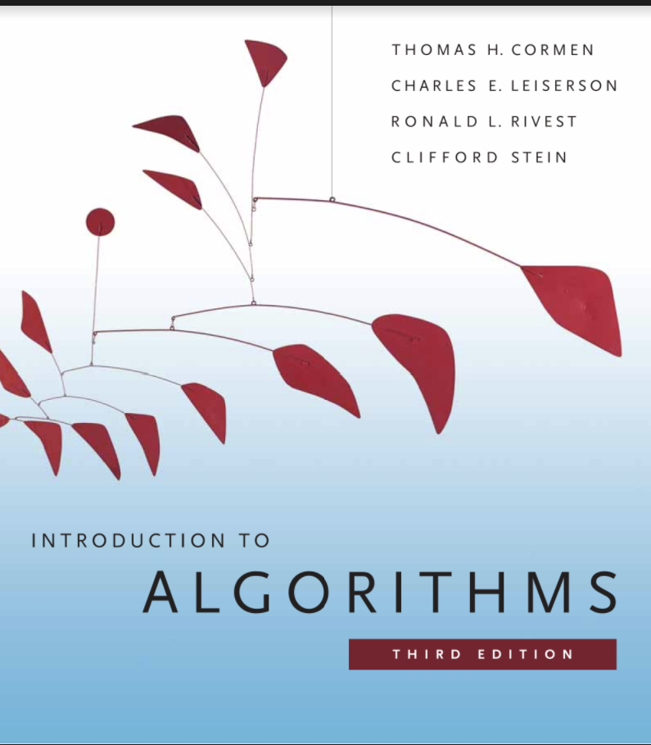
References

